Slide 1


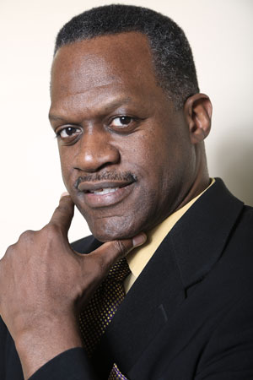

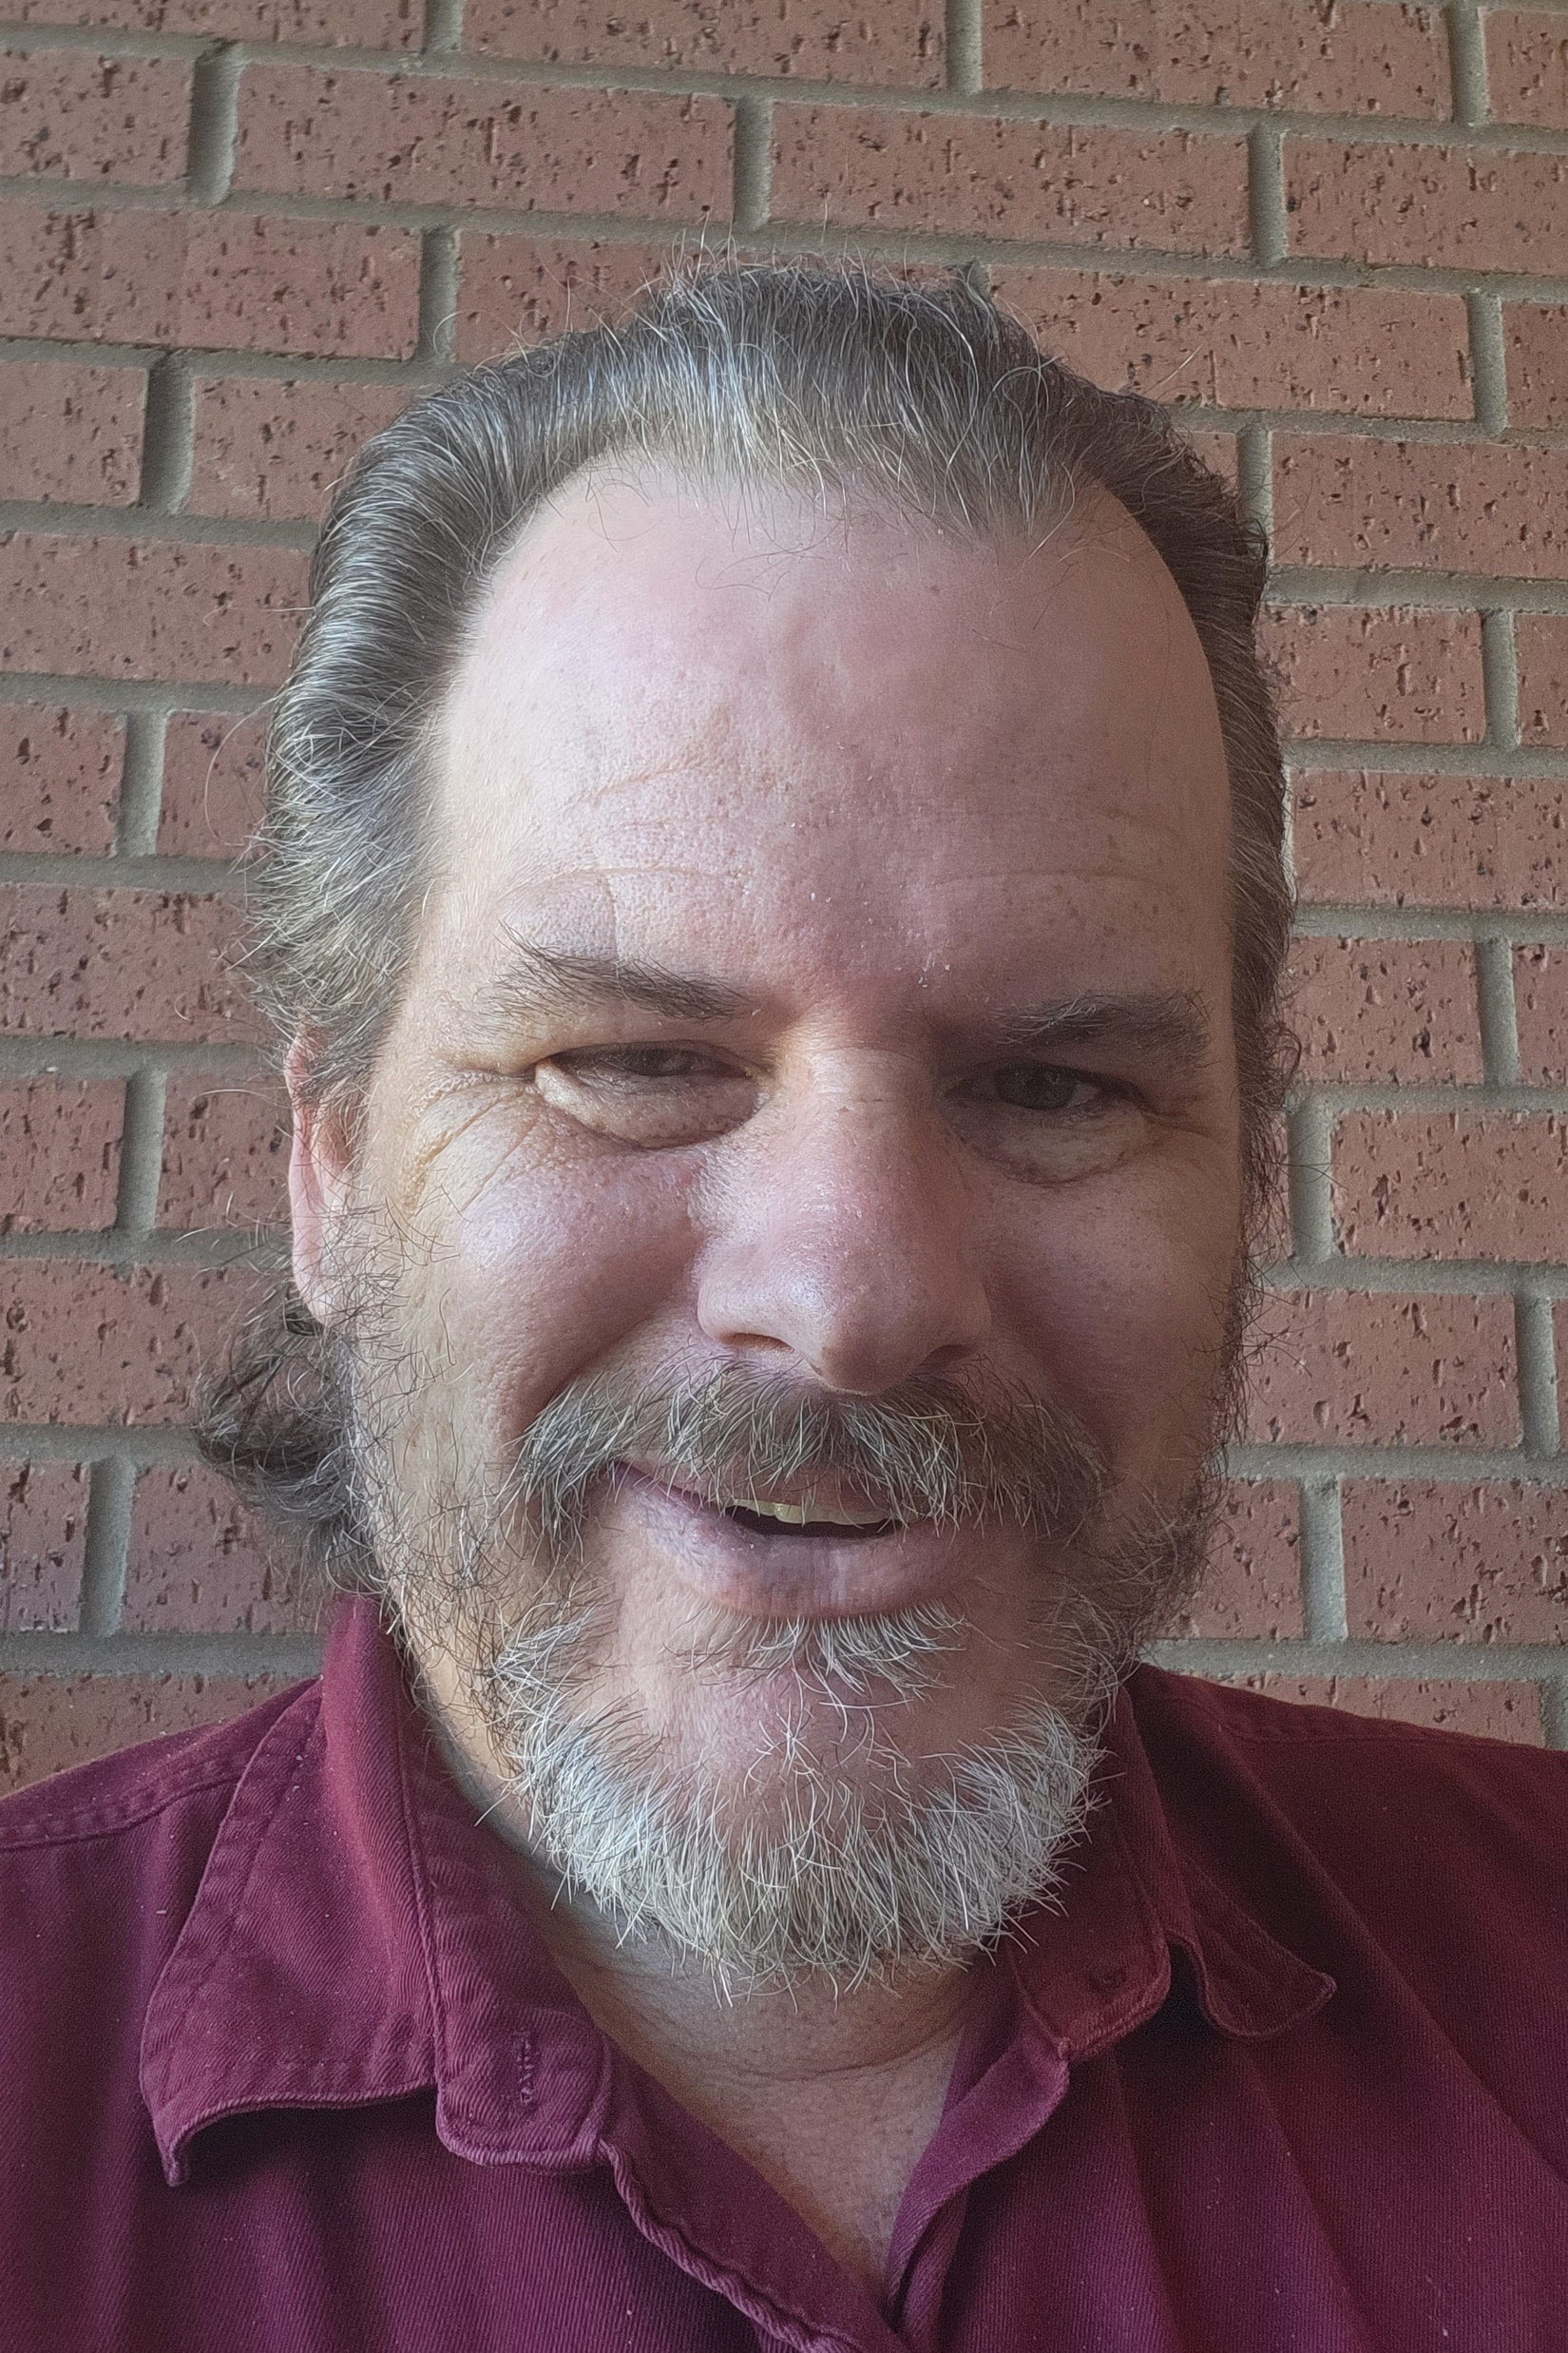


Team Tech Tigers
Alfred Watkins
Department Chair
Computer Science Department
Morehouse College
BS Morehouse College
BEE & PhD Georgia Institute of Technology
Not Pictured
Fernanda Foertter
Voltron Data
Jacqueline Jackson
Interim Chair
Department of Electrical & Computer Engineering and Computer Science
Jackson State University
BS Computer Science Jackson State University
MS & PhD Computer Science – Auburn University
Andrew Overton
Adjunct Professor
Department of Electrical & Computer Engineering and Computer Science
Jackson State University
BS & MS Computer Science – Jackson State University
Team Song: Weird Science by Oingo Boingo

Slide 2
Target Course & Goals
Team Tech Tigers
Target Course:
ECE 101 – Introduction to Electrical & Computer Engineering
Goals:
- Expand the Introduction to Computers to include an introduction to High Performance Computing
- Introduce students to cloud services including GitHub and AWS
- Expand students’ understanding of the need for HPC professionals
Url to our team GitHub repository: https://github.com/jackson820/TeamTechTigers

Slide 3
Course Description
Team Tech Tigers
Proposed Revised Course Description: ECE 101 – Introduction to Electrical & Computer Engineering
This course gives first year students a survey of the field of the electrical and computer
engineering. Topics include the different subareas within the electrical and computer engineering field, professional careers for ECE students and the analytical tools that will be utilized throughout the curriculum. The course discusses the curriculum, the available technical electives, basic concepts that will be used in the course of study, and a brief history of computing from the abacus to supercomputers, and professional careers for ECE students.

Slide 4
Potential Resources
Team Tech Tigers
Potential Resources:
Introduction to SSH: https://www.wikihow.com/Use-SSHH
Introduction to the Linux command line: https://overthewire.org/wargames/bandit/
Introduction to GitHub: https://docs.github.com/en/get-started/quickstart/hello-world
Introduction to Version Control: https://swcarpentry.github.io/git-novice/
Introduction to VS Code: https://code.visualstudio.com/docs/getstarted/introvideos
VS Code Editor and IDE: https://code.visualstudio.com/
GitHub CodeSpaces Primer: https://education.github.com/experiences/primer_codespaces
GitHub Codespaces: https://github.com/codespaces

Slide 5
Syllabus Changes
Team Tech Tigers
The only change to the Syllabus would be the Course Description and the Course Objectives
Course Description: ECE 101 – Introduction to Electrical & Computer Engineering
This course gives first year students a survey of the field of the electrical and computer
engineering. Topics include the different subareas within the electrical and computer engineering field, professional careers for ECE students and the tools that will be utilized throughout the curriculum. The course discusses the curriculum, the available technical electives, basic concepts that will be used in the course of study, and a brief history of computing from the abacus to supercomputers, and professional careers for ECE students.
Course Objectives
Add an objective: Explain the history of computing machines.

Slide 6
Exercises for students
Team Tech Tigers
First Exercise: Get familiar with GitHub using online tutorials to be provided
Second Exercise: Set up a GitHub account and repository
Third Exercise: Create a README file in the repository with background information about the student
Fourth Exercise(?): Create an AWS Educate account and begin learning about cloud services
Fifth Exercise: Get familiar with SSH and the Linux command line using the Bandit online game

Slide 7
Cloud service Resources
Team Tech Tigers
GitHub: github.com
AWS Educate: aws.amazon.com/education
Google for Education: edu.google.com

